Slide 1

Nội dung
Include and require
Cookies
Session
File Upload
Error Handling
Exception Handling
OOP PHP
Notes:
DEMO Tổng thể một bài từ include tới Exception handling

Slide 2
Include and require
Use require when the file is required by the application.
Use include when the file is not required and application should continue when file is not found.

Slide 3
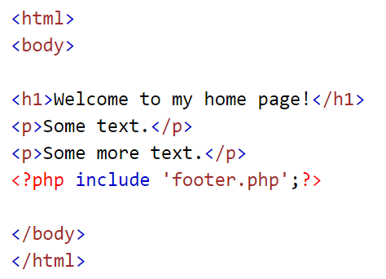
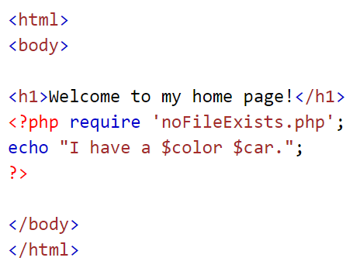
Include and require

Slide 4
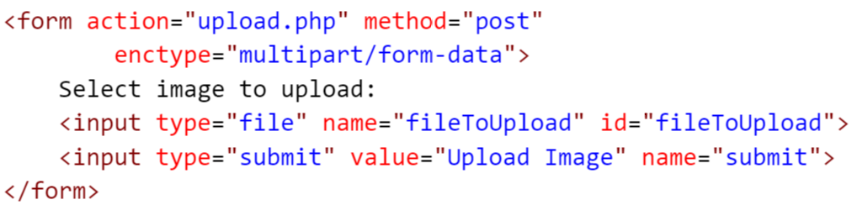
File Upload

Slide 5
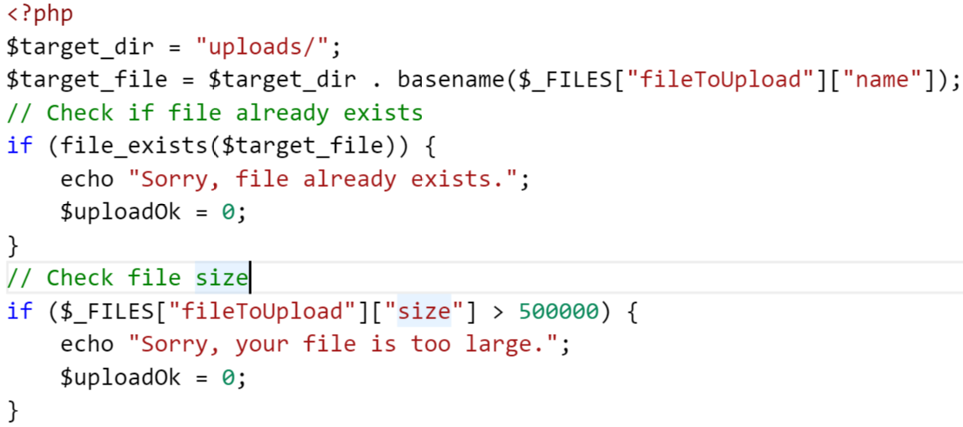
File Upload

Slide 6
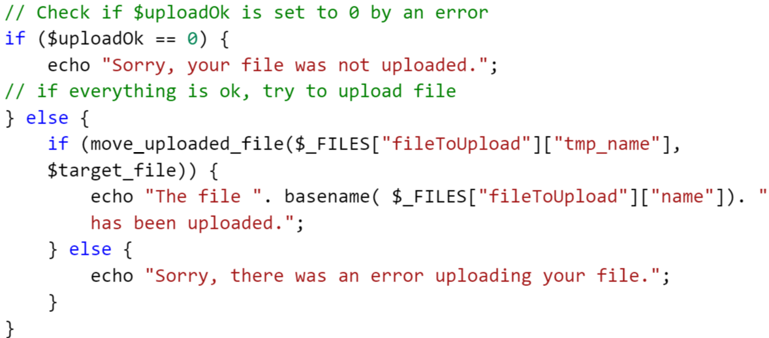
File Upload

Slide 7
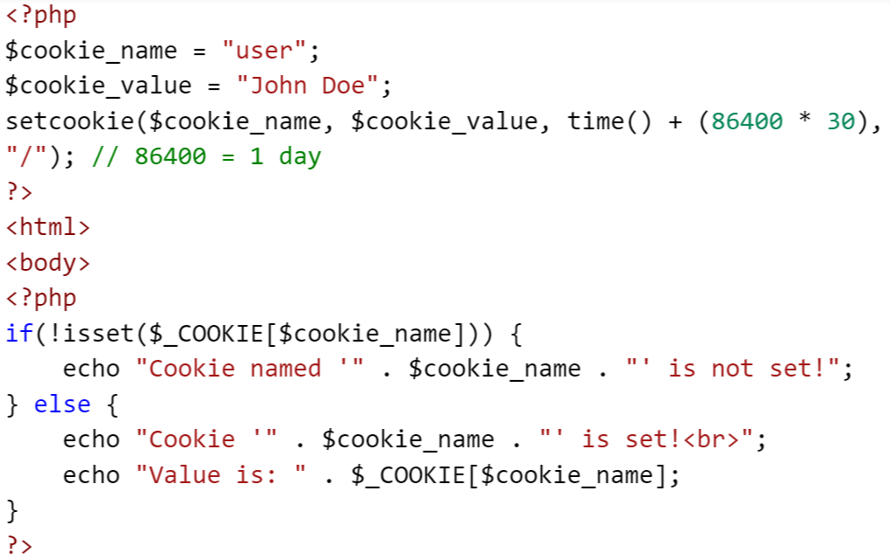
Cookies

Slide 8
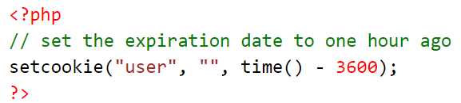
Cookies - Modify
To modify a cookie, just set (again) the cookie using the setcookie() function
Cookies - Delete
To delete a cookie, use the setcookie() function with an expiration date in the past:

Slide 9
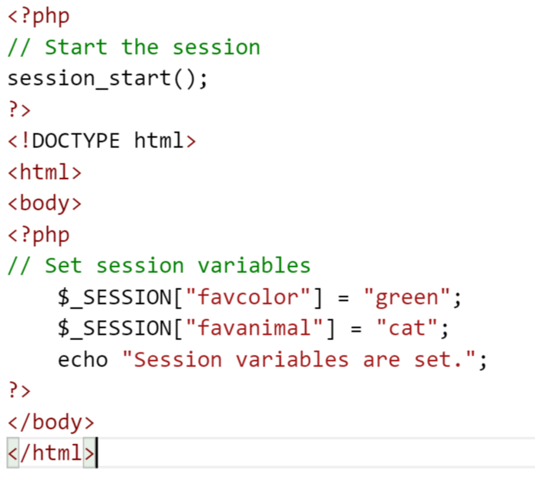
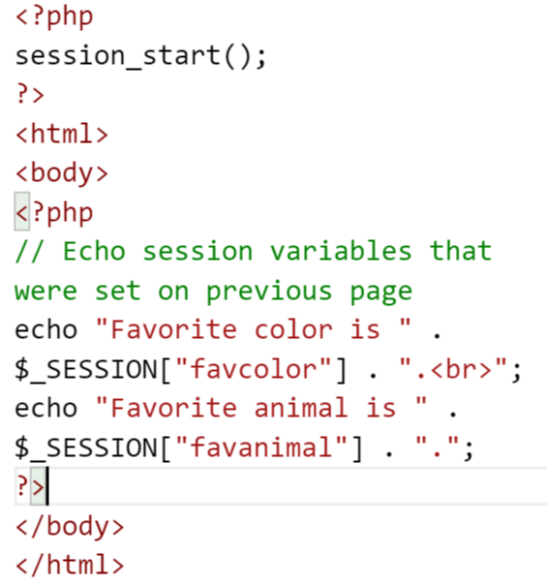
Sessions

Slide 10
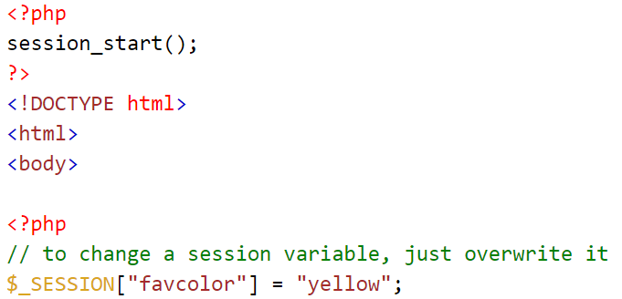
Sessions - Modify
To change a session variable, just overwrite it

Slide 11
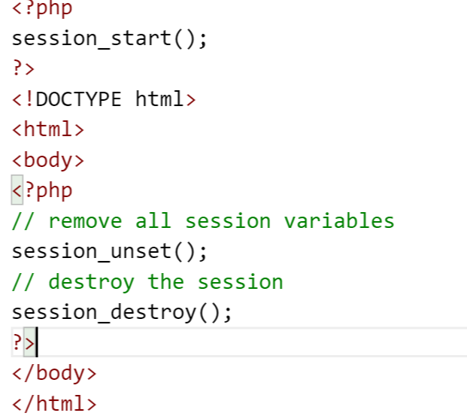
Destroy a PHP Session
To remove all global session variables and destroy the session, use session_unset() and session_destroy():

Slide 12
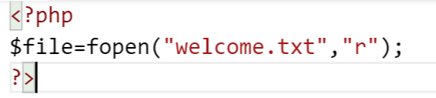
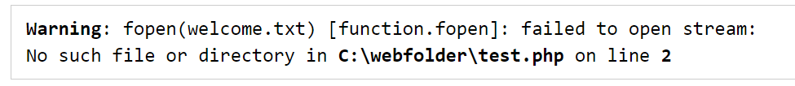
Error Handling

Slide 13
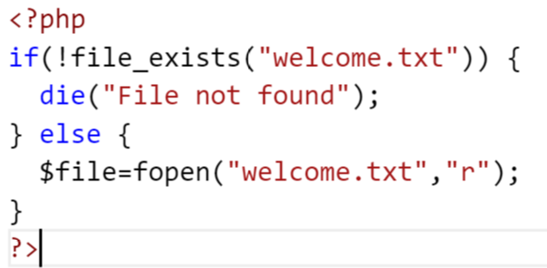

Error Handling

Slide 14
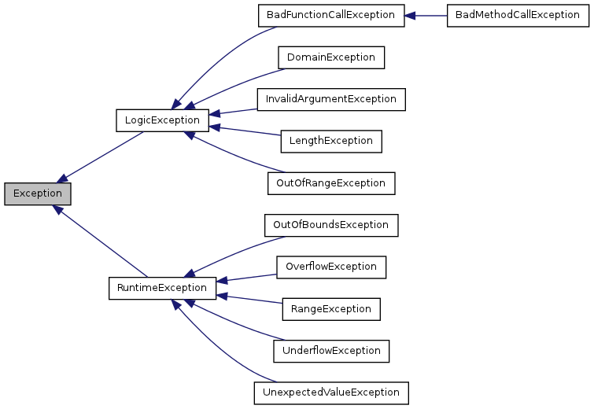
Exception Handling

Slide 15
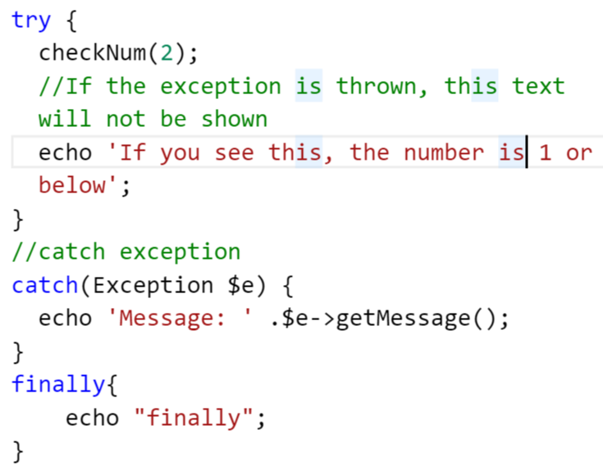
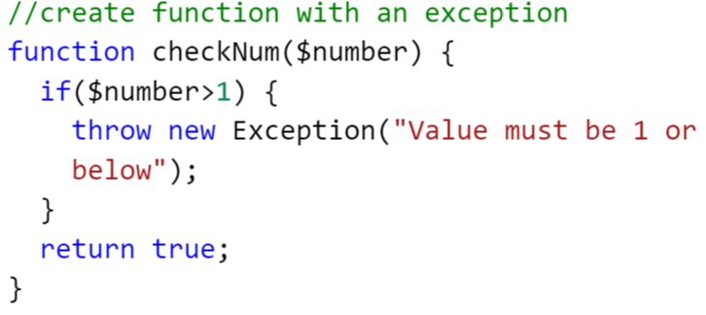
Exception Handling

Slide 16
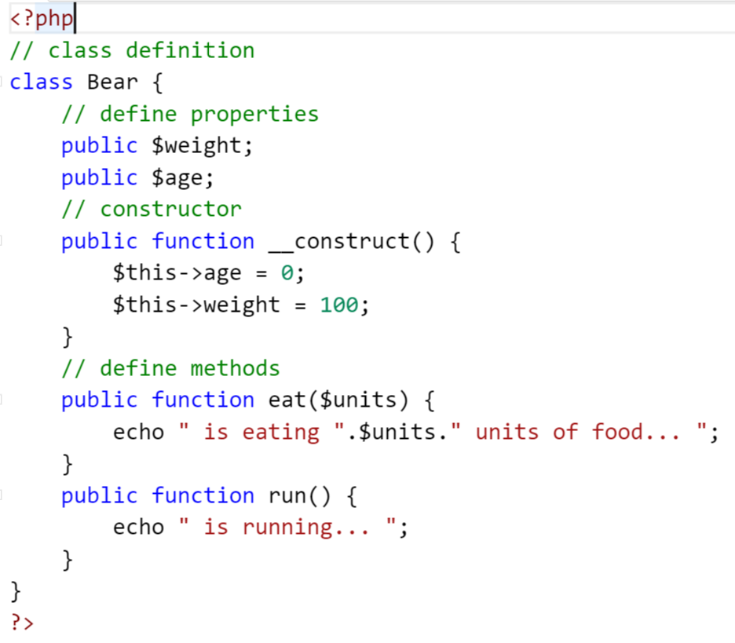
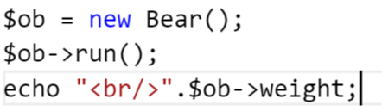

OOP PHP

Slide 17
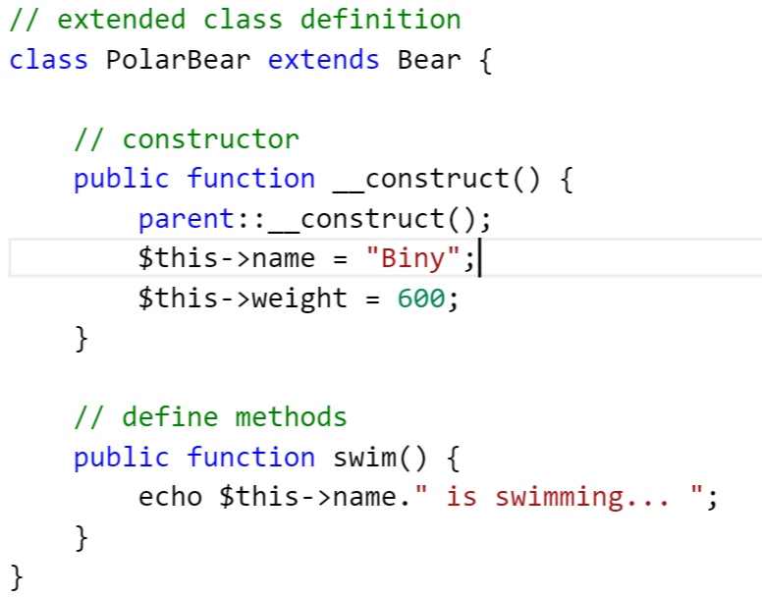
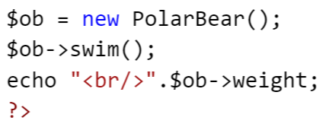

OOP PHP

Slide 18
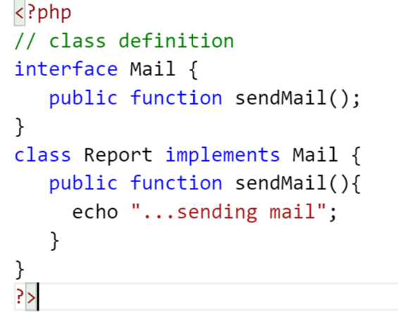
OOP PHP - interface

Slide 19
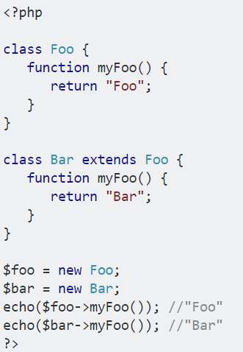
OOP PHP - overriding

Slide 20
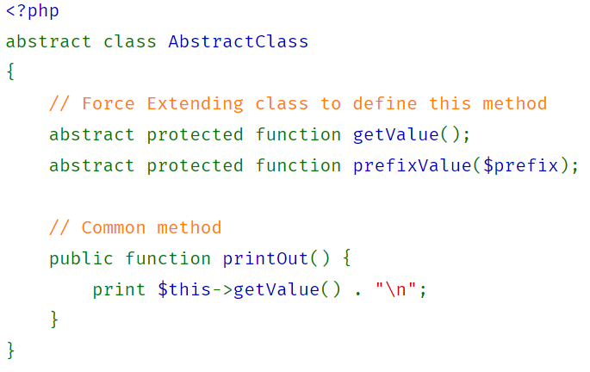
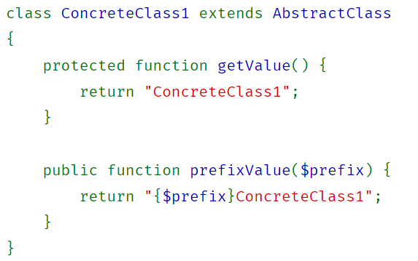
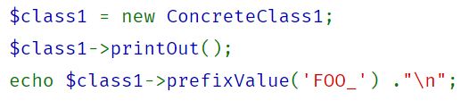
OOP PHP – Abstract class
Cannot instantiate abstract class

Slide 21
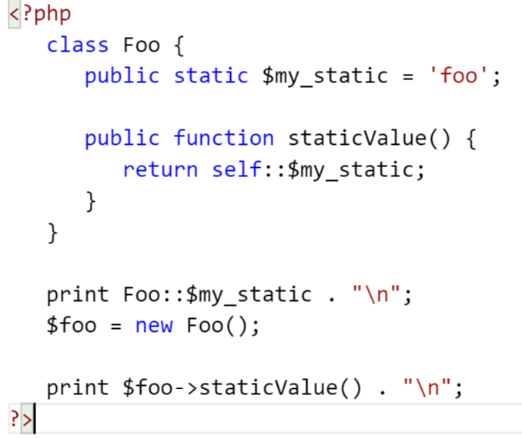
Static Keyword

Slide 22
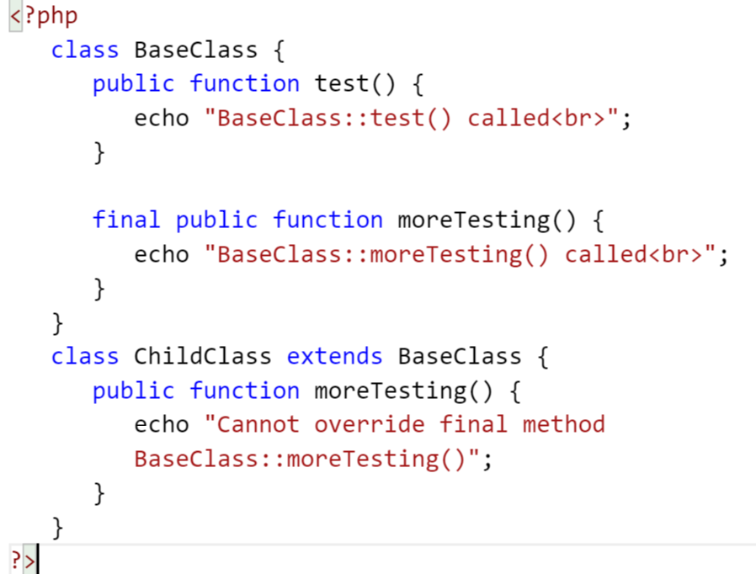
Final Keyword
Fatal error: Cannot override final method

